Slide 1
KNOTBOOK
AN ONLINE LEARNING PLATFORM
Guided by
Minnu Elizabeth Ittan
Assistant Professor
MBITS, Nellimattom
Done by
Gokul G Nair (MBI21CS035)
Sheena S Saiju (MBI21CS055)
Solaman Aji (MBI21CS056)
Susan Paul (MBI21CS057)

Slide 2
CONTENTS
ABSTRACT
INTRODUCTION
OBJECTIVES
LITERATURE SURVEY
PROPOSED SYSTEM
ARCHITECTURE DESIGN
MODULE DESIGN
IMPLEMENTATION
DATASET
TECHNOLOGY STACK
CONCLUSION
REFERENCES

Slide 3
ABSTRACT
Knotbook is an online platform that facilitates easy sharing of study materials
Automatically creates various practice questions (multiple-choice and short-answer) from uploaded documents using NLP
The system generates a comprehensive collection of assessments without manual input
Evaluation is also done by the system and generates report cards
Provides an interactive learning experience that boosts student involvement

Slide 4
INTRODUCTION
Online learning has evolved rapidly due to advancements in Internet and communication technology
Despite benefits, challenges like low engagement and high dropout rates remain
A Virtual Learning Environment is needed to enhance educational experience and improve student engagement
VLE automates assessment and monitoring by generating diverse questions
This system has potential to transform education by improving student outcomes, increasing retention rates and enabling more personalized learning experiences

Slide 5
OBJECTIVES
To create a platform for faculty to upload, organize and share study materials with students
To enable students to take online exams with system-generated questions from uploaded documents
To allow students to use text-voice conversion facility during exams
To evaluate the assessments and generate progress report without manual interaction

Slide 6
LITERATURE SURVEY
Slno. | Paper | Technology Used | Advantages | Disadvantages
1. | MCQGen: A Large Language Model-Driven MCQ Generator for Personalized Learning [1] | Large Language Model (LLM) Integration (GPT-4) Retrieval-Augmented Generation (RAG) | Incorporates feedback for question improvement Guided question generation | Struggles with complex mathematics Limited diversity and complexity
2. | UniRaG: Unification, Retrieval and Generation for Multimodal Question Answering With Pre-Trained Language Models[2] | LLaVA for Image-to-Text Pre-trained Language Model (Flan-T5-Base) | High-quality answer generation Provides detailed image descriptions | Risk of information overload Possibility of conversion errors from multimodal data
Notes:
Spiking Neural Networks (SNN) in-depth interview

Slide 7
LITERATURE SURVEY
Slno. | Paper | Technology Used | Advantages | Disadvantages
3. | Opinerium: Subjective Question Generation Using Large Language Models [3] | Flan-T5 trained on local computers GPT-3 trained on OpenAI’s servers | Emphasizes personal insights in question generation Enhanced performance through fine-tuning | Challenging quality assessment Significant computing costs
4. | Leveraging Structured Information from a Passage to Generate Questions [4] | Dataset: RACE4QG Encoder: GRU with Graph Attention Network (GAT) embeddings Decoder: Attention and Pointer Networks | Utilizes multiple input sources for question generation Combines template-based and neural techniques | Difficulty with unstructured data Limited applicability across question types
Notes:
Spiking Neural Networks (SNN) in-depth interview

Slide 8
LITERATURE SURVEY
Slno. | Paper | Technology Used | Advantages | Disadvantages
5. | A Study on an Intelligent Algorithm for Automatic Test Paper Generation and Scoring in University English Exams [5] | Improved Genetic Algorithm (IGA) for Question Selection Constraint-Based Test Paper Generation | Balanced Question Distribution Customizable Difficulty Levels Automated Scoring Support | Subjective Limitations Algorithm Complexity Constraint Dependence
6. | Automatic Exam Correction Framework (AECF) for the MCQs, Essays and Equations Matching [6] | Embeddings: Word2Vec, FastText, GloVe, USE Similarity: HMB-MMS-EMA, Cosine, Pearson | Hybrid Question Support Intelligent Equation Matching | Limited Complex Equation Support High Computation Needs
Notes:
Spiking Neural Networks (SNN) in-depth interview

Slide 9
LITERATURE SURVEY
Slno. | Paper | Technology Used | Advantages | Disadvantages
7. | Toward Robust Evaluation: A Comprehensive Taxonomy of Datasets and Metrics for Open Domain Question Answering in the Era of Large Language Models [7] | Open-Domain Question Answering (ODQA) Techniques: - Retriever-Reader - Retriever-Only - Generator-Only LLM-Based Evaluation | Comprehensive Evaluation Taxonomy Holistic ODQA Assessment Optimized for LLM | LLM-Focused Complex Evaluation Metrics Limited Real-Time Application Focus
8. | Automatic Question Generation from Given Paragraph (IJSRD) [8] | Preprocessing: Tokenization, POS Model: Seq2Seq Evaluation: BLEU, Human Feedback | Personalized Learning Cross-Domain Application | Ambiguous Text Handling Issues Limited Question Types
Notes:
SMIS 2.0 (Spill Management Information System 2.0): A 3D hydrodynamic and chemical spill modeling system.
GLLVHT Model: Provides hydrodynamic information for contaminant transport.
COSIM Model: Simulates chemical/oil spill impact.
GIS (Geographic Information Systems): Used for visualizing spill results and spatial queries.
ArcMap: A tool within ESRI’s ArcGIS suite for managing and displaying spill data.

Slide 10
LITERATURE SURVEY
Slno. | Paper | Technology Used | Advantages | Disadvantages
9. | Investigating Educational and Noneducational Answer Selection for Educational Question Generation [9] | Data Preprocessing: Tokenization, POS Tagging Question Generation: Seq2Seq, Transformers Evaluation Metrics: BLEU, ROUGE | Dual-mode answer selection Ensures contextual relevance | Low accuracy in complex domains Difficult to distinguish
10. | A Systematic Review of Automatic Question Generation for Educational Purposes[10] | Classification of Methods: Template-Based, Rule-Based, Machine Learning Models Evaluation Metrics: BLEU, ROUGE, Human Assessments | Comprehensive review across domains Focuses on evaluation benchmarks | Limited AI capabilities Potential bias in selected literature
Notes:
Spiking Neural Networks (SNN) in-depth interview

Slide 11
CONS OF EXISTING SYSTEM
High Computational Requirements :
Needs powerful GPUs/CPUs for processing
Not suitable for low-resource environments
Difficulty with Complex Questions:
Struggles with subjective questions
Handles ambiguity poorly in generated questions
Dependence on Quality Data:
Requires structured, high-quality datasets
Poor performance with noisy or unstructured data
Notes:
Limited Regional Focus: Existing systems are often generalized and not tailored to specific regions, leading to less accurate predictions.
Lack of Real-Time Data Integration: Many systems rely on periodic updates, which delay responses to changing conditions.
Reactive Spill Management: Systems mostly offer pre-configured or manual responses, making them less efficient in real-time crisis management.
Inadequate Stakeholder Communication: Existing systems may not provide clear, actionable insights for all relevant stakeholders.
Simplified Models: Many systems use basic models, failing to capture the complexity of water flow dynamics and spill risks.
Inefficient Water Resource Management: Limited focus on optimizing water flow between dams and overall resource allocation.

Slide 12
PROPOSED SYSTEM
Automated Question Generation – Uses T5, BERT and Sense2Vec models to generate MCQs and subjective questions from uploaded documents.
Online Examination Platform – Conducts tests based on the generated questions.
Automated Answer Evaluation – Analyses responses for accuracy and relevance.
Performance Analysis – Generates graphical insights on student performance.
Notes:
Limited Regional Focus: Existing systems are often generalized and not tailored to specific regions, leading to less accurate predictions.
Lack of Real-Time Data Integration: Many systems rely on periodic updates, which delay responses to changing conditions.
Reactive Spill Management: Systems mostly offer pre-configured or manual responses, making them less efficient in real-time crisis management.
Inadequate Stakeholder Communication: Existing systems may not provide clear, actionable insights for all relevant stakeholders.
Simplified Models: Many systems use basic models, failing to capture the complexity of water flow dynamics and spill risks.
Inefficient Water Resource Management: Limited focus on optimizing water flow between dams and overall resource allocation.

Slide 13
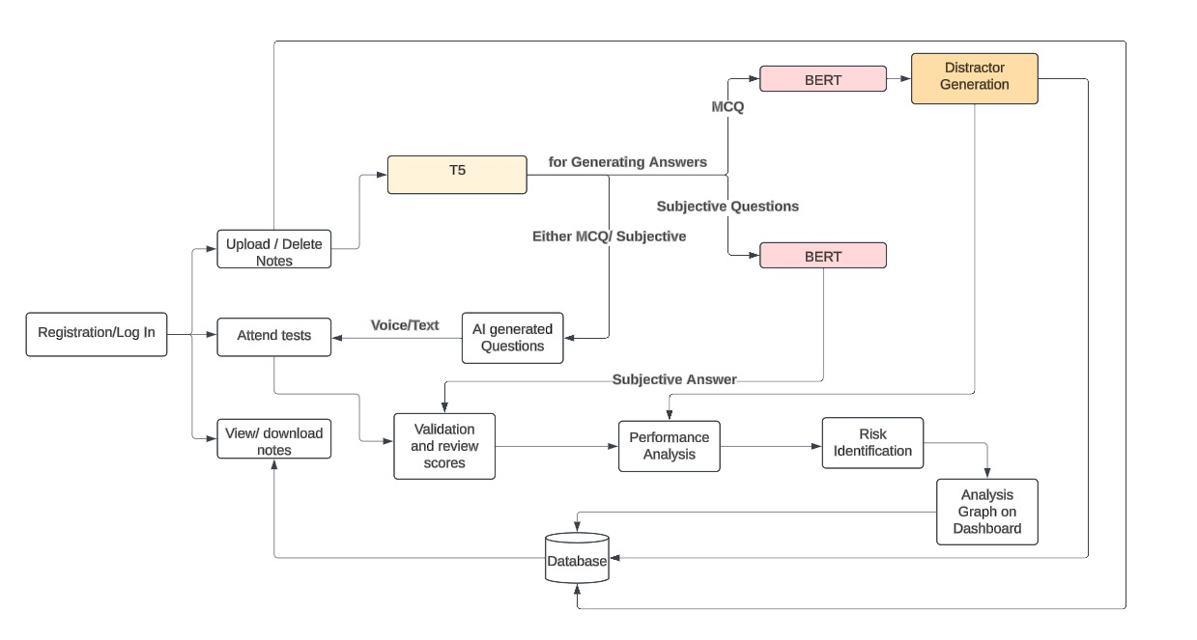
ARCHITECTURE DESIGN

Slide 14
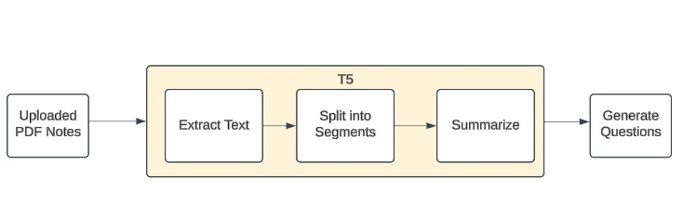
ARCHITECTURE DESIGN
T5-Model

Slide 15
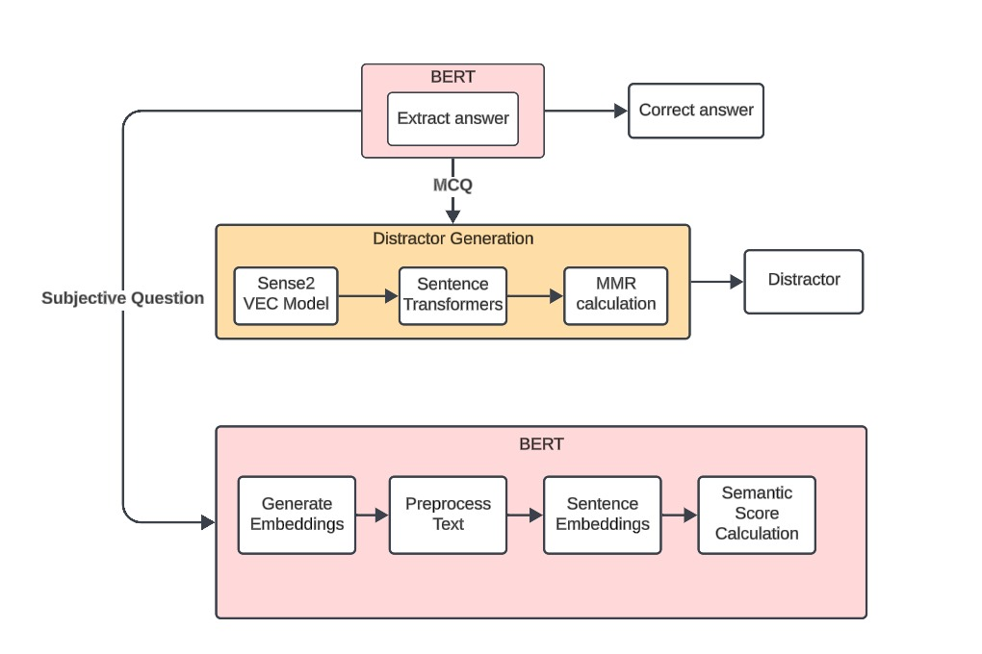
ARCHITECTURE DESIGN
BERT-Model

Slide 16
MODULE DETAILS
Automatic Question Answer Generation
Text-Voice Conversion
Answer Validation
Progress Reporting

Slide 17
MODULE DETAILS
Automatic Question Answer Generation:
Question Types: Multiple-choice, true/false, short answer.
Text Extraction: Extract text content from PDF notes using PyPDF2.
Question Generation: Using T5 Transformer model.
Answer Generation: Using BERT Transformer model
Distractor Generation for MCQ: Using Sense2Vec model,word vector model

Slide 18
MODULE DETAILS
2. Text-Voice Conversion:
Text-to-Voice Engine: Integration with text-to-speech (TTS) services.
Voice-to-Text Engine: Integration with speech-to-text (STT) services.
Web Speech API: TTS and STT services
TTS: speechSynthesis interface
STT: SpeechRecognition interface

Slide 19
MODULE DETAILS
3. Answer Validation:
Automatic Grading: Validate and score student answers
Grading System: Assign scores based on correctness
For MCQ questions: correct answer is stored in database
For subjective questions: semantic score is calculated and stored in database
Sentence transformer is used for finding similarity score

Slide 20
MODULE DETAILS
4. Progress Reporting:
Student Performance Tracking: Track and display student progress.
Performance Analytics: Detailed analysis of student performance over time.
Progress Dashboard: Visualize student performance metrics.

Slide 21
IMPLEMENTATION
PDF Upload and Text Extraction
Text Extraction: PyPDF2 to extract text from the uploaded PDF document.
Segmenting Text: Split the extracted text into manageable segments or paragraphs
Text Summarization
Load T5 Model: Use the T5 model for text summarization.
Summarization Process: For each segment of text, feed it into the T5 model to generate a concise summary.

Slide 22
IMPLEMENTATION
Question Generation
Load T5 Model: Use the T5 model specifically for generating questions.
MCQ and Subjective Question Generation
Answer Extraction for Questions
BERT Integration: Use BERT model to extract the correct answer from the summarized text.
Storing Questions and Answers: Store the generated questions and their corresponding correct answers in a database

Slide 23
IMPLEMENTATION
Distractor Generation for MCQs
Sense2Vec model: To find semantically similar words or phrases.
Sentence Transformers: Generate Embeddings for Semantic Similarity
Maximal Marginal Relevance (MMR): Apply MMR to select distractors that are contextually relevant but distinct from correct answer
Final MCQ Options: Combine the correct answer and generated distractors to create the final set of answer choices for each MCQ.

Slide 24
IMPLEMENTATION
Answer Validation
MCQ Validation: Compare the user's answer with the correct answer stored in the database.
Subjective Answer Validation:
Semantic Score Calculation:
- Generate Embeddings
- Preprocess Text
-Compute Semantic Score
-Validation Criteria

Slide 25
PROS OF PROPOSED SYSTEM
Optimized Computational Efficiency:
Efficient on both powerful and low-resource environments
Advanced Handling of Complex and Subjective Questions:
Improved processing complex and ambiguous text.
Context-aware reasoning and enhanced natural language understanding.
High-Quality Distractor Generation:
Advanced distractor generation mechanism
Improved training and testing quality.
Notes:
Limited Regional Focus: Existing systems are often generalized and not tailored to specific regions, leading to less accurate predictions.
Lack of Real-Time Data Integration: Many systems rely on periodic updates, which delay responses to changing conditions.
Reactive Spill Management: Systems mostly offer pre-configured or manual responses, making them less efficient in real-time crisis management.
Inadequate Stakeholder Communication: Existing systems may not provide clear, actionable insights for all relevant stakeholders.
Simplified Models: Many systems use basic models, failing to capture the complexity of water flow dynamics and spill risks.
Inefficient Water Resource Management: Limited focus on optimizing water flow between dams and overall resource allocation.

Slide 26
DATASET
The SQuAD (Stanford Question Answering Dataset) is a widely used benchmark dataset in NLP.
Used especially for tasks related to reading comprehension, question answering and question generation.
SQuAD enhances AQG by training Seq2Seq models to generate answer-aware and context-aware questions.
Fine-tuning, paraphrasing and reinforcement learning improve fluency, coherence and diversity, making it a crucial dataset for question generation.
Notes:
SQuAD (Stanford Question Answering Dataset) is a widely used dataset in natural language processing for training and evaluating question-answering systems.
To use SQuAD with T5 for extracting questions and answers from a PDF, start by extracting and preprocessing the text from the PDF.
Fine-tune T5 on the SQuAD dataset, which contains question-answer pairs and contexts, to train the model in generating relevant questions.
After fine-tuning, input the cleaned PDF text into the model to generate questions and extract answers based on the context provided.

Slide 27
DATASET
Column Name | Description | Data Type
id | Unique question ID | Integer
title | Article title | String
context | Article text | String
question | Question text | String
answers | Answer(s) to the question | List of Strings
answer_start | Starting character index of answer | Integer
answer_end | Ending character index of answer | Integer
Notes:
SQuAD (Stanford Question Answering Dataset) is a widely used dataset in natural language processing for training and evaluating question-answering systems.
To use SQuAD with T5 for extracting questions and answers from a PDF, start by extracting and preprocessing the text from the PDF.
Fine-tune T5 on the SQuAD dataset, which contains question-answer pairs and contexts, to train the model in generating relevant questions.
After fine-tuning, input the cleaned PDF text into the model to generate questions and extract answers based on the context provided.

Slide 28
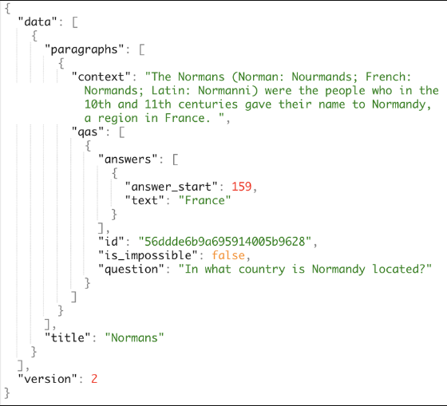
DATASET
Notes:
SQuAD (Stanford Question Answering Dataset) is a widely used dataset in natural language processing for training and evaluating question-answering systems.
To use SQuAD with T5 for extracting questions and answers from a PDF, start by extracting and preprocessing the text from the PDF.
Fine-tune T5 on the SQuAD dataset, which contains question-answer pairs and contexts, to train the model in generating relevant questions.
After fine-tuning, input the cleaned PDF text into the model to generate questions and extract answers based on the context provided.

Slide 29
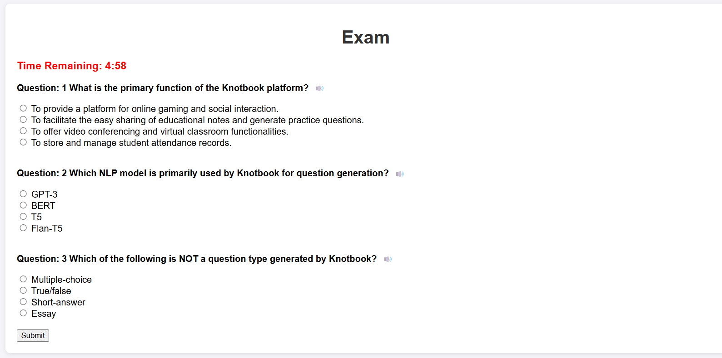
OUTPUT
Generated MCQ Questions and options

Slide 30
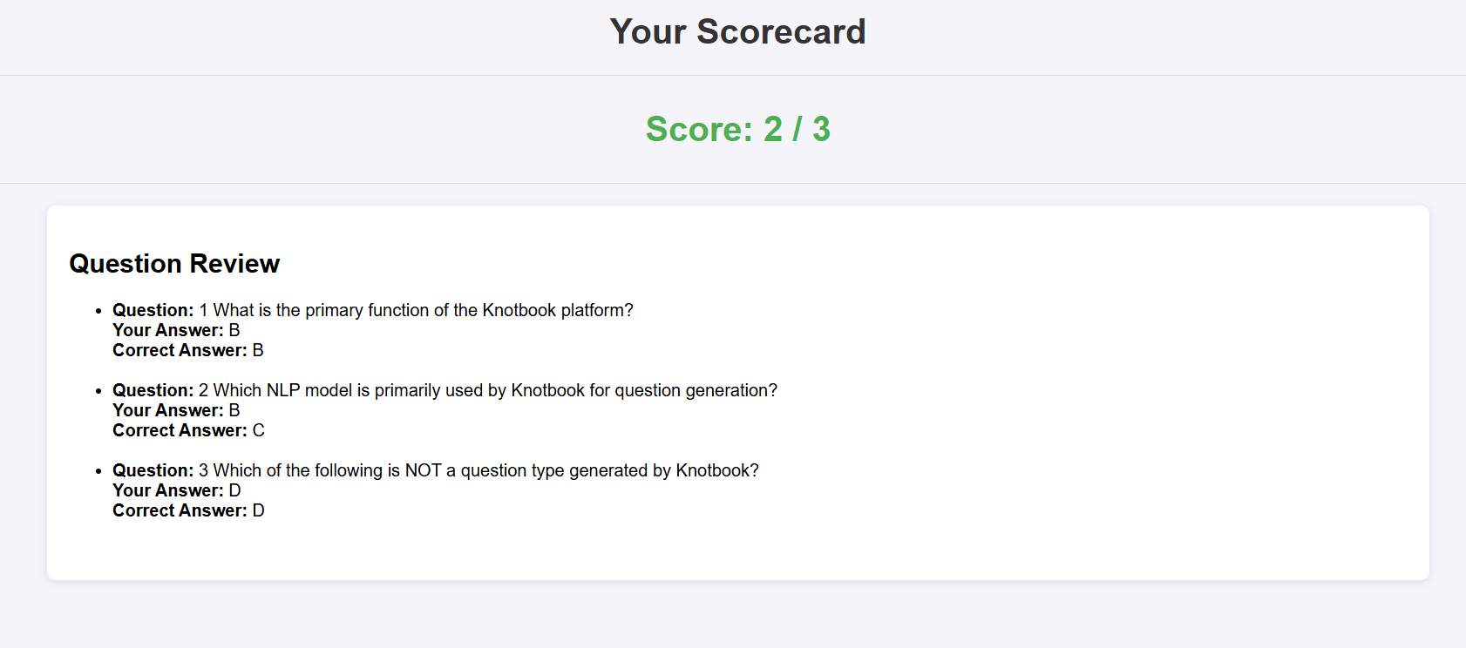
OUTPUT
Scorecard of MCQ

Slide 31
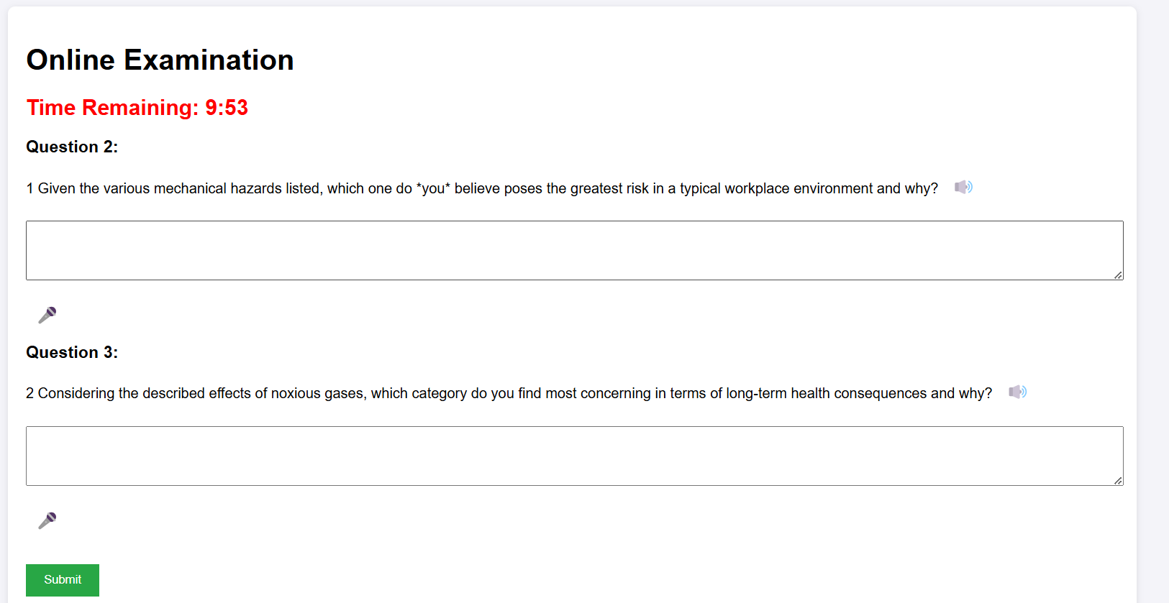
OUTPUT
Subjective question generator

Slide 32
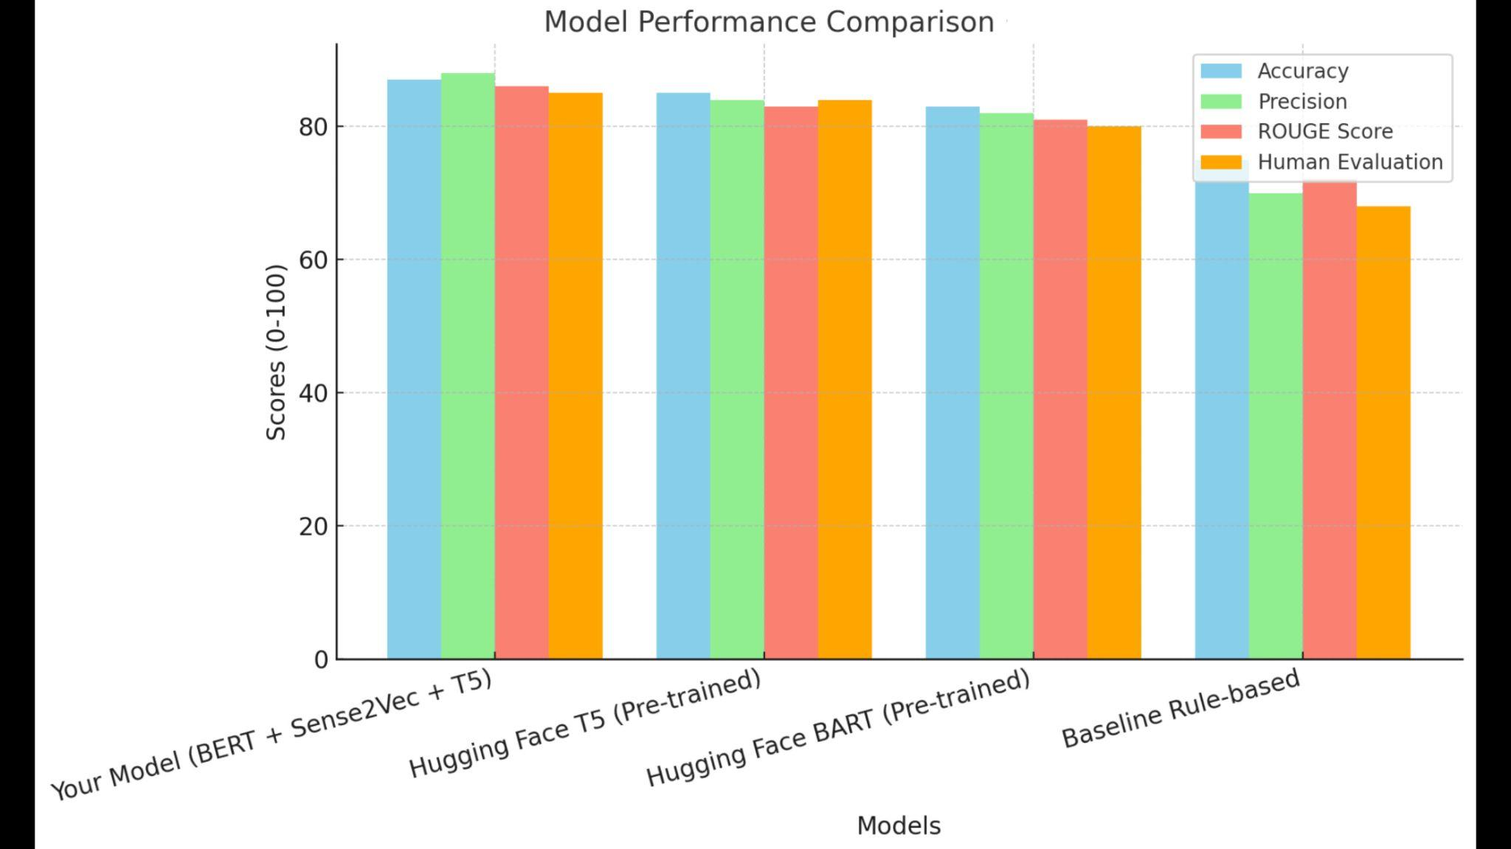
MODEL COMPARISON
MCQ generator model

Slide 33
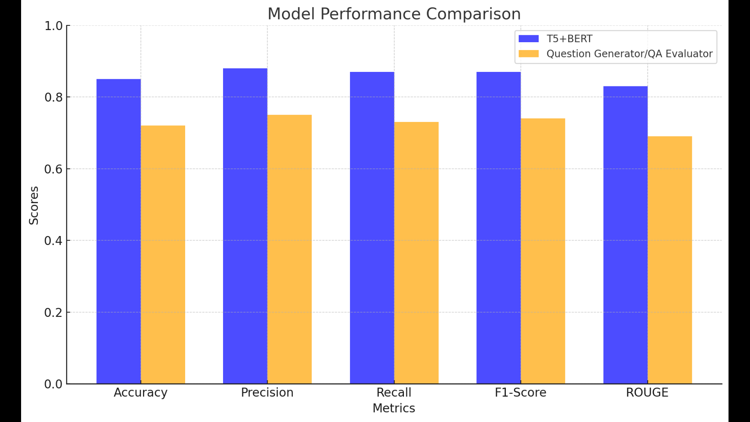
MODEL COMPARISON
Subjective question model

Slide 34
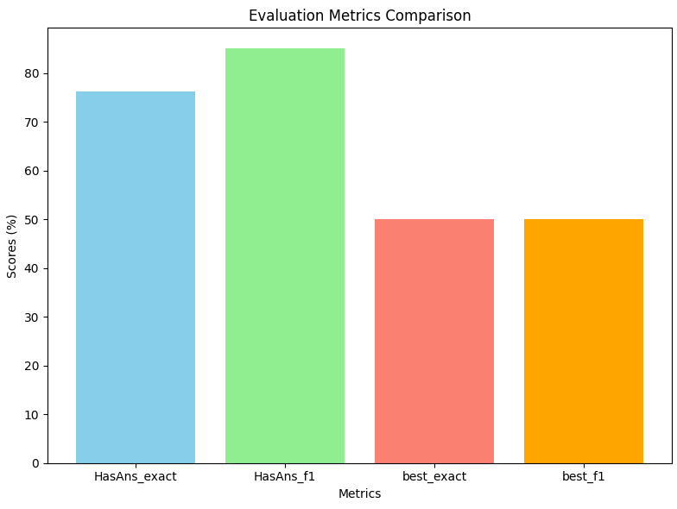
MODEL COMPARISON
BERT model after fine tuning

Slide 35
TECHNOLOGY STACK
SOFTWARE REQUIREMENTS
Operating System: Windows 8 or above
Programming language:Python 3.9
IDE:Visual Studio Code,Google Colab
Front-end:HTML,CSS,Python
Back-end:Django
Database:MysQL

Slide 36
TECHNOLOGY STACK
HARDWARE REQUIREMENTS
Processor: 12th Gen Intel Core i7
Processor Speed: 2.4GHz
Memory: 32 GB RAM
Graphics Card: NVIDIA RTX A4000
Hard Disk Capacity: 1 TB

Slide 37
CONCLUSION
Automates question generation from PDF notes, improving efficiency and saving educator’s time.
Identifies at-risk students, enabling personalized interventions and support.
Provides analysis of student performance with evaluation information.
Future enhancements include attention tracking, sentiment analysis, adaptive learning modules, collaborative features and gamification.
Contributes to an inclusive learning environment, enhancing academic performance and supporting quality education.

Slide 38
REFERENCES
[1]Ching Nam Han, Chee Wei Tan ,Pei Duo-You ,” MCQGen: A Large Language Model-Driven MCQ Generator for Personalized Learning”,IEEE Access,Vol12,pp,102261-102273,2024, Doi:10.1109/ACCESS.2024.3420709
[2]Q. Z. Lim, C. P. Lee, K. M. Lim, and A. K. Samingan, "UniRaG: Unification, Retrieval, and Generation for Multimodal Question Answering With Pre-Trained Language Models," IEEE Access, vol. 12, pp. 71505–71512, May 2024, doi: 10.1109/ACCESS.2024.3403101

Slide 39
REFERENCES
[3]Babakhani, P., Lommatzsch, A., Brodt, T., Sacker, D., Sivrikaya, F., & Albayrak, S. "Opinerium: Subjective Question Generation Using Large Language Models," IEEE Access, vol. 12, pp. 66085–66092, May 2024, doi: 10.1109/ACCESS.2024.3398553
[4]J. Xu, Y. Sun, J. Gan, M. Zhou, and D. Wu, “Leveraging Structured Information from a Passage to Generate Questions” ,Tsinghua Science and Technology, vol. 28, no. 3, pp. 464–474, Jun. 2023, doi: 10.26599/TST.2022.9010034​

Slide 40
REFERENCES
[5]H. Yang, "A Study on an Intelligent Algorithm for Automatic Test Paper Generation and Scoring in University English Exams," *Journal of ICT Standardization*, vol. 11, no. 4, pp. 391-402, 2023. doi: [10.13052/JICTS2245-800X.1144]
[6]H. M. Balaha and M. M. Saafan, "Automatic Exam Correction Framework (AECF) for the MCQs, Essays, and Equations Matching," IEEE Access, vol. 9, pp. 32368-32372, Feb. 2021, doi: 10.1109/ACCESS.2021.3060940​

Slide 41
REFERENCES
[7] A. Srivastava and A. Memon, "Toward Robust Evaluation: A Comprehensive Taxonomy of Datasets and Metrics for Open Domain Question Answering in the Era of Large Language Models," IEEE Access, vol. 12, pp. 117483-117489, Sep. 2024, doi: 10.1109/ACCESS.2024.3446854​
[8]H. G. Deokate, P. P. Jogdand, P. S. Satpute, and S. B. Shaikh, "Automatic Question Generation from Given Paragraph," International Journal for Scientific Research & Development (IJSRD), vol. 7, no. 3, pp. 1521-1523, Mar. 2019
​

Slide 42
REFERENCES
[9] T. Steuer, A. Filighera, and T. Tregel, "Investigating Educational and Noneducational Answer Selection for Educational Question Generation," IEEE Access, vol. 10, pp. 63522-63536, Jun. 2022, doi: 10.1109/ACCESS.2022.3180838​
[10]G. Kurdi, J. Leo, B. Parsia, U. Sattler, and S. Al-Emari, "A Systematic Review of Automatic Question Generation for Educational Purposes," International Journal of Artificial Intelligence in Education, vol. 30, pp. 121-147, 2019, doi: 10.1007/s40593-019-00186-y

Slide 43
THANK YOU

